Slide 2
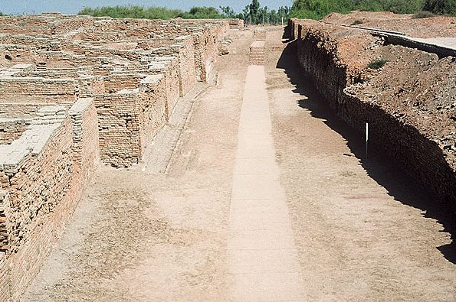
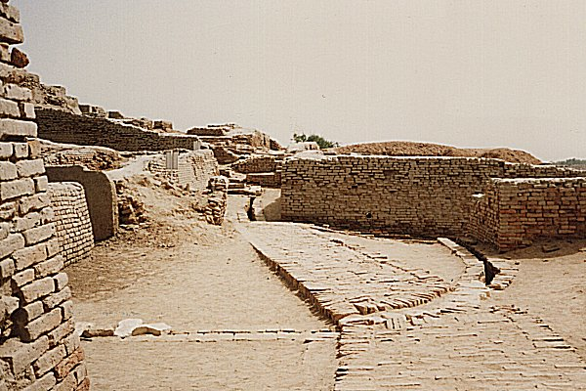
Feature 1: Cities
Example: Mohenjo-Daro (from Indus River Valley)
-Gridded streets
-Sewage system

Slide 3
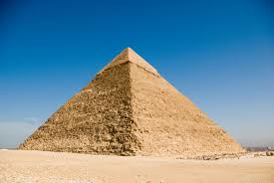
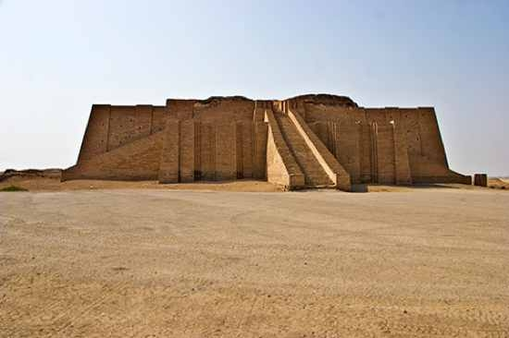
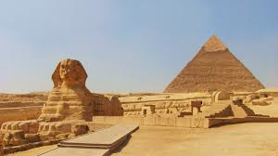
Feature 2: Art/Architecture
Example: Pyramids
(from Egypt)
-Burial sites for royalty
Example: Ziggurats
(from Mesopotamia)
-In the centers of cities

Slide 4
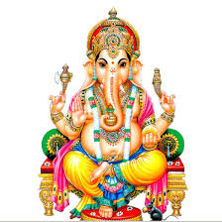
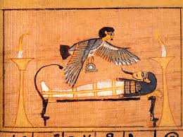
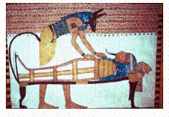
Feature 3: Religions
Definition
Not as organized as religions today, but most civilizations believed in some form of polytheism
(belief in many gods)

Slide 5
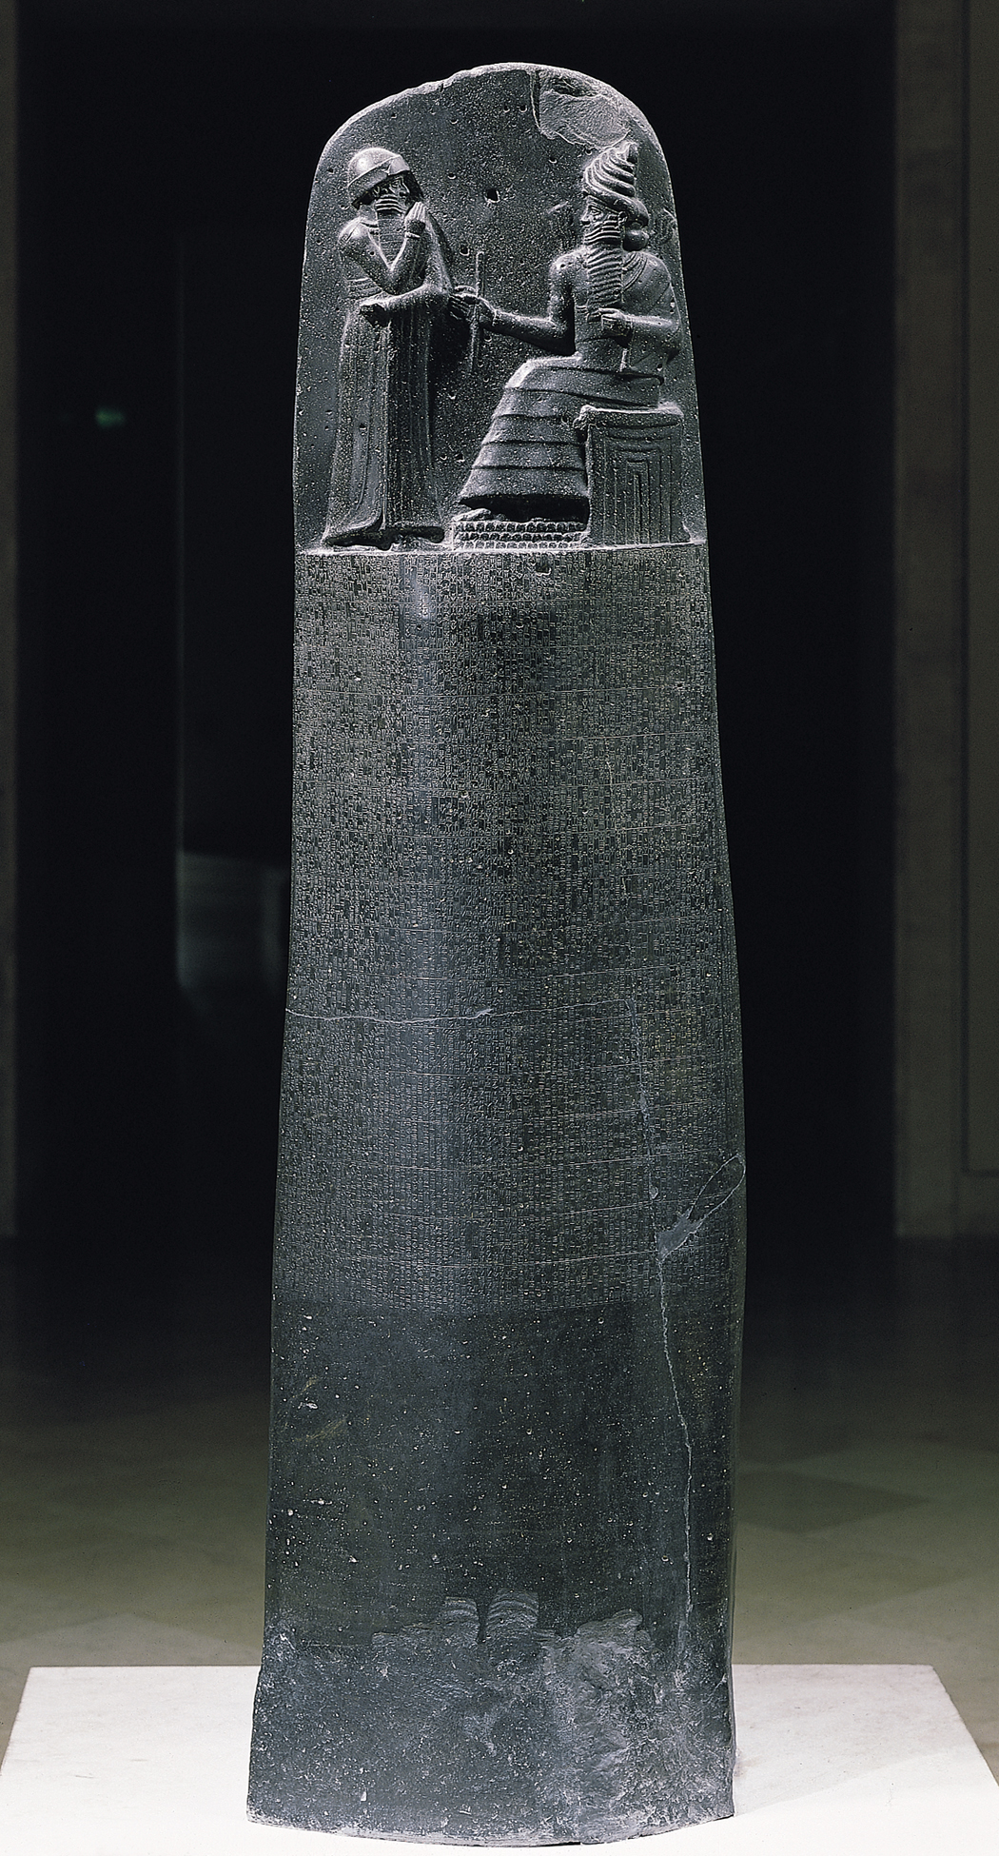
Feature 4: Governments
Example: Code of Hammurabi
(From Mesopotamia)
-King Hammurabi placed these all over his kingdom
-Included laws like minimum wage, no incest, and the famous “eye for an eye” law.

Slide 6
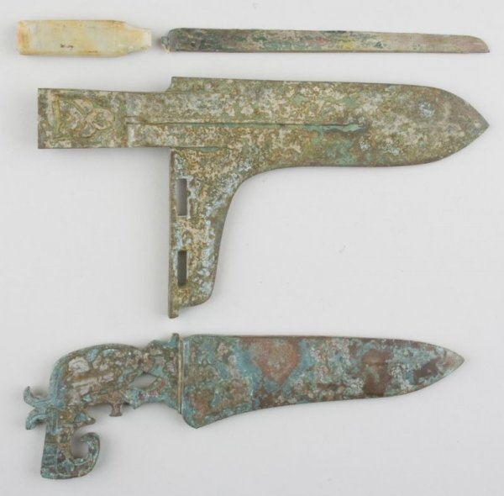
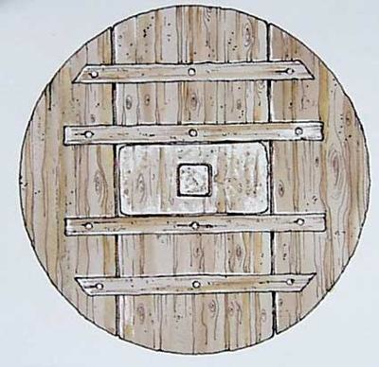
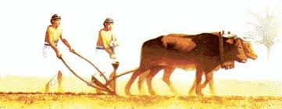
Feature 5: Advanced Technology
Example: toothbrushes & toothpaste
(From Egypt)
Example: the plow
(From Mesopotamia)
Example: the wheel
(From Mesopotamia).
Example: bronze tools & weapons
(From China)

Slide 7
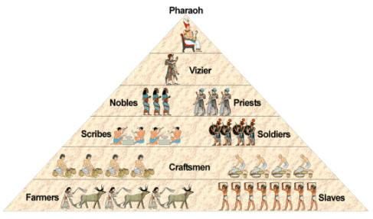
Feature 6: Social Classes
Definition:
How people in society are divided

Slide 8
Feature 7: Job Specialization
Definition:
People begin doing specific tasks & jobs
(priests, warriors, farmers, artisans, traders, etc)

Slide 9
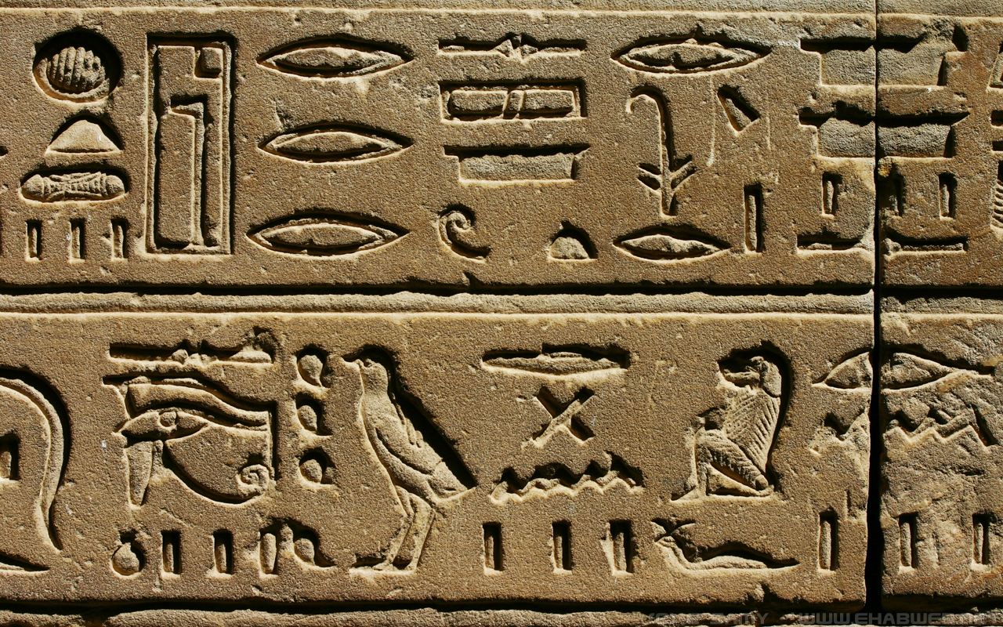
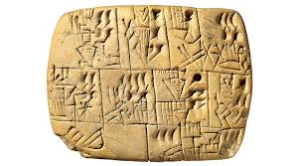
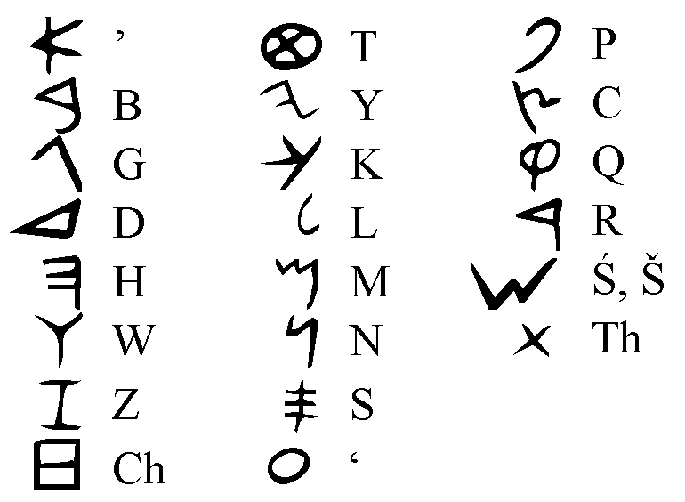
Feature 8: Writing Systems
Example: Hieroglyphics
(from Egypt)
Example: Cuneiform
(from Mesopotamia)
Example: Phoenician Alphabet (from Palestine)

