Slide 1
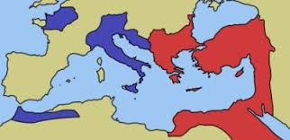

Slide 2
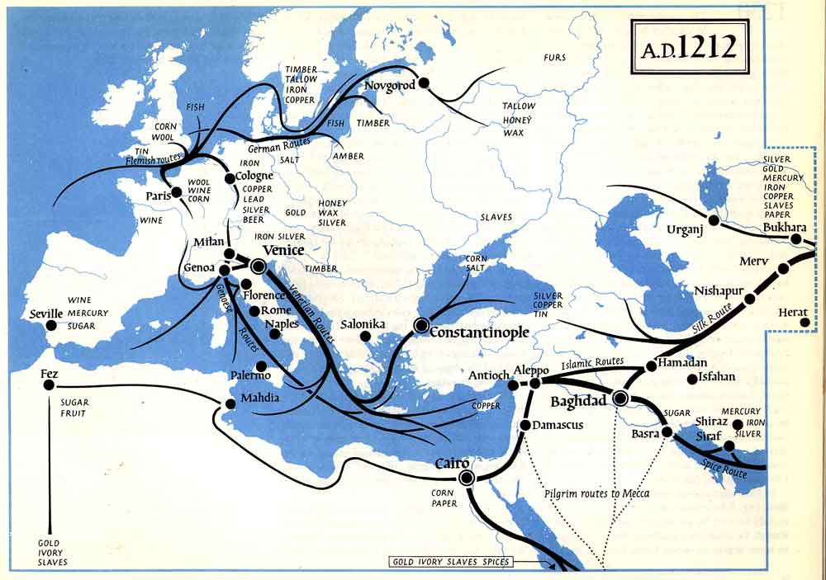

Slide 3
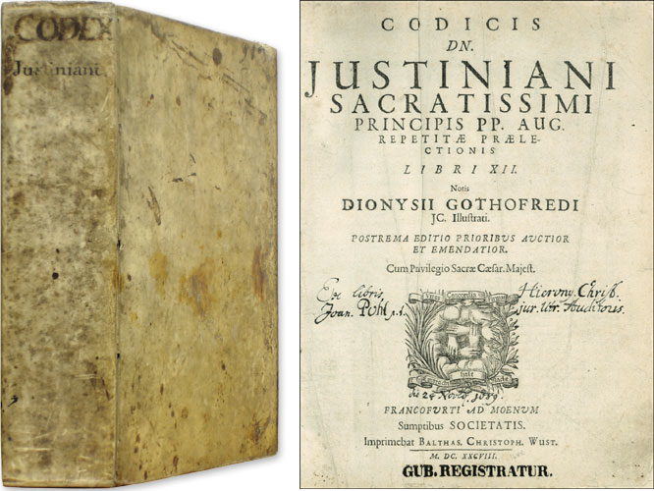
Context: In A.D. 528 the Emperor Justinian began a review of the old Roman laws. There were thousands of Roman laws that ordered life in the empire. The emperor chose ten men to review 1,600 books full of Roman Law and create a simpler legal code. These men were able to create the Justinian Code with just over 4,000 laws.
Notes:
Why was Justinian’s Code so important?

Slide 4
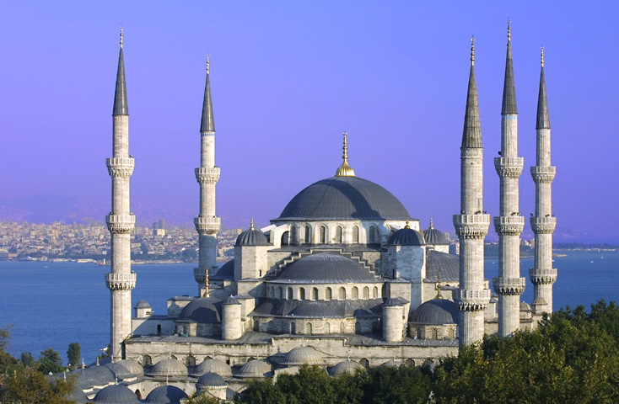
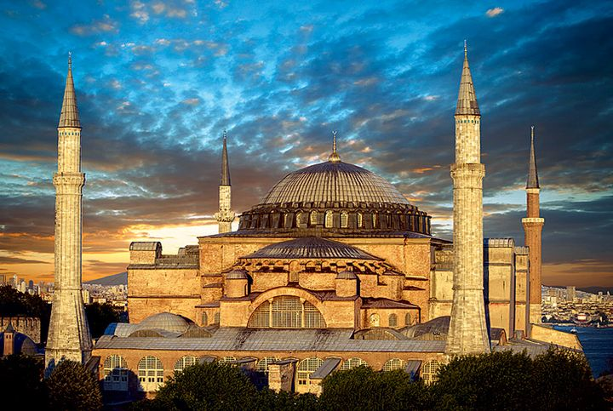
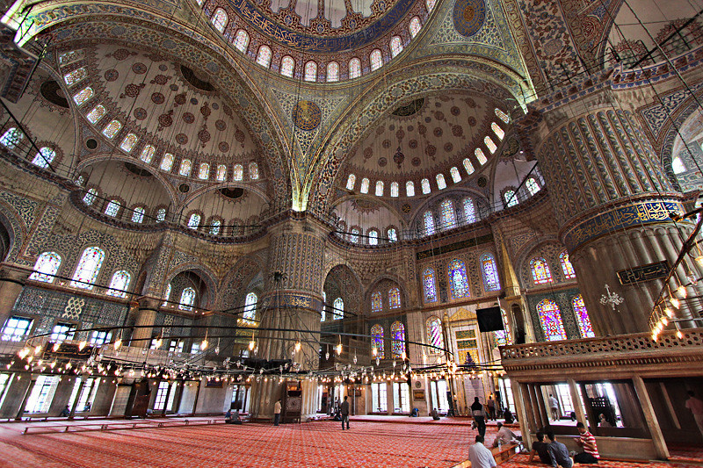
Sultan Ahmed Mosque in Istanbul, built 1616
Interior Sultan Ahmed Mosque in Istanbul, built 1616
Hagia Sophia
Notes:
-What are some key architectural features you notice in the Hagia Sophia?
-What can you infer about the level of governmental organization needed to build such a structure?
-What can you infer about what religion was common in the Byzantine empire, and its importance in everyday life?
-Where did the materials come from? What can you infer about the trade system occurring at the time?
-Are there any similarities/differences you notice between Byzantine Empire and Roman Empire?

Slide 5
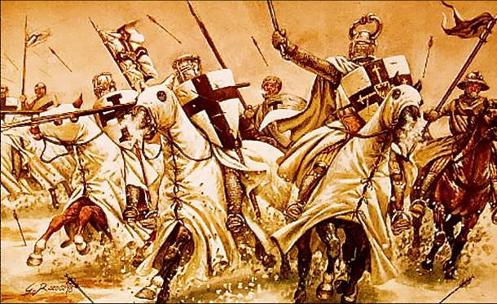
May 6, 2015
1. What are the Crusades?
Series of wars fought by Western European knights, at the request of the pope, with the goal of taking the Jerusalem back from the Muslims AND defending the Byzantine Empire from the Muslim Turks
Learning Target: I can explain key information about the Umayyad and Abbasid caliphates
Do Now: -
Homework: None, probably

Slide 6
Why was Jerusalem and the Holy Land important?
Judaism
Christianity
Islam
Western Wall
Church of the Holy Sepulcher
Dome of the Rock

Slide 7
The Situation in the Middle East
1009- Anti-Christian Fatimid Caliph destroyed the Church of the Holy Sepulchre in Jerusalem (made Christians really angry)
Mid-1000s- Muslim Turks arrived and conquered a huge piece of the Middle East and Egypt, including Byzantine land very close to Constantinople

Slide 8
The Situation in Western Europe
Church tried to stop the violent behavior of knights against fellow Christians by banning fighting during holy days and forbid killing, but it was not working
Recent issues like the the Great Schism (1054) made Western Christians more passionately religious

Slide 9
A Cry for Help
Byzantine Emperor asked Pope Urban II (his rival) to send a small elite force of knights to help him fight the Seljuk Turks
1095: Pope Urban II calls on nobles and bishops to fight a Crusade against the Muslim Turks

