Slide 1
What is capitalism?
Economic system in which most of the means of production are privately owned.
Operates on the principles of supply & demand.

Slide 2
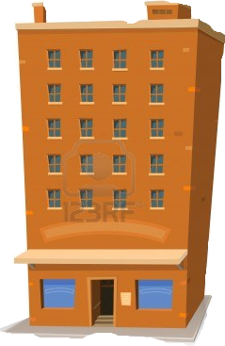
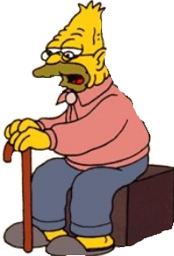
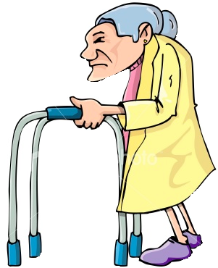
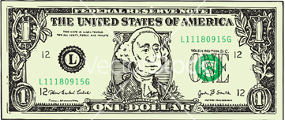
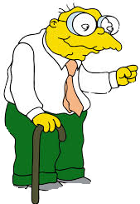
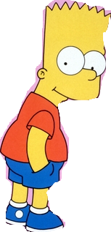
I want coffee but I’m old and it’s too far for me to walk!
Bart’s Coffee Delivery Service, Inc.
Everybody’s happy!

Slide 3
Capitalist
Nationalized
Capitalist
Nationalized

Slide 4
Do you think Grampa would be okay paying $10 for his $3 coffee to be delivered?
Is Bart the producer or consumer?
What is his goal?

Slide 5
2). Characteristics of a Capitalist Economy
a). Self-interest
--Producers want to make money
--Consumers want the lowest price possible
b). Competition
-If there is only one producer of a certain product, a monopoly can form.
-Competition among several producers ensures that no one person controls
the market.

Slide 6
Pimply Nerd’s Coffee Delivery Service, Inc.

Slide 7
Characteristics of a Capitalist Economy
2. Competition
-If there is only one producer of a certain product, a monopoly can form.
-Competition among several producers ensures that no one person controls
the market.
-Producers must make their products more attractive than their competitor’s product (marketing, price)

Slide 8
How will Grampa decide which company to buy from?
Pimply Nerd’s Coffee Delivery Service, Inc.

Slide 9
Part 2: Capitalism Game
Each group will be given a set of supplies. Your mission is to create a product using only those supplies, construction paper, and glue sticks.
Tomorrow, you will “shop” at each other’s stores. Whoever has the most money wins our capitalist game.
Before you begin working, take a second a brainstorm with you group. Ask yourself: what makes people want to buy certain products instead of others? Required elements:
Either an advertisement or a brand
A cost for your item
A brief description of your product below

Slide 10
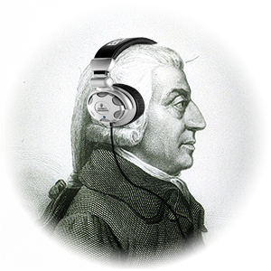
Aim: Is capitalism democratic?
Capitalism Pro’s
Capitalism Con’s
Encourages Innovation
Belief that it can lead to social mobility
Always an impoverished class
Profit can concentrate in the hands of a few

