Slide 1
Medieval Europe

Slide 2
Social Classes/Economy

Slide 3
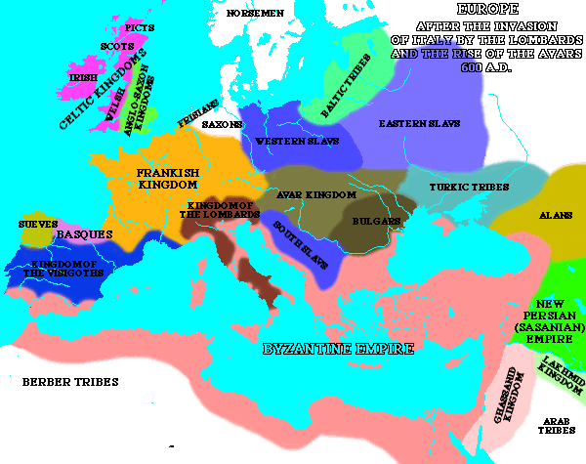

Slide 4
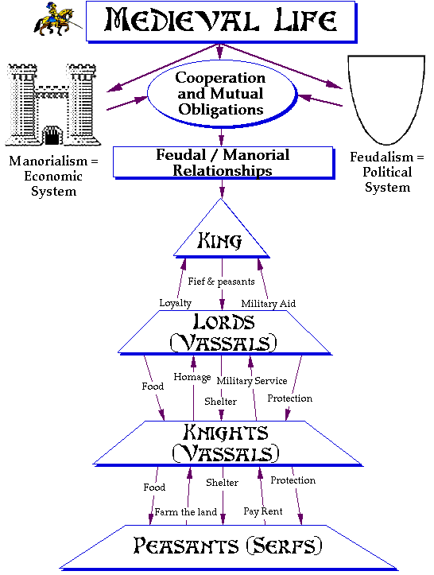

Slide 5
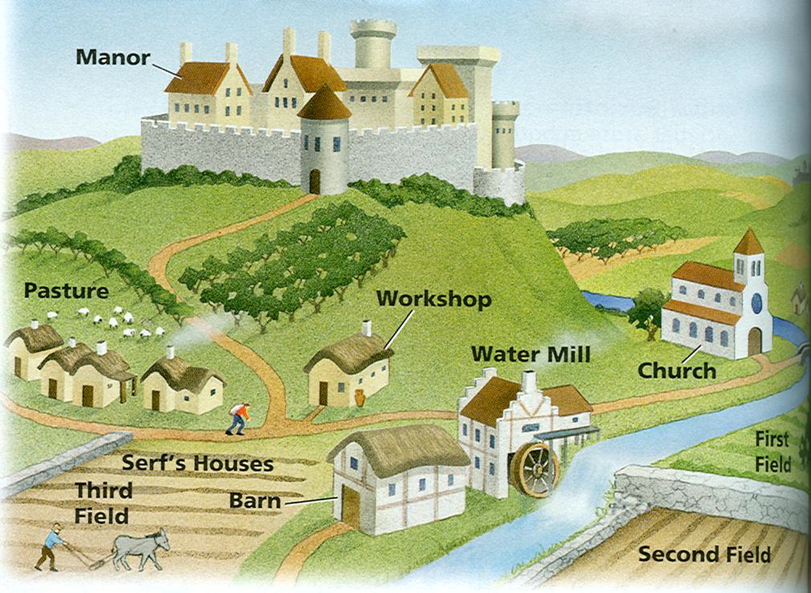

Slide 6
Religion
(Role of Catholic Church)

Slide 7
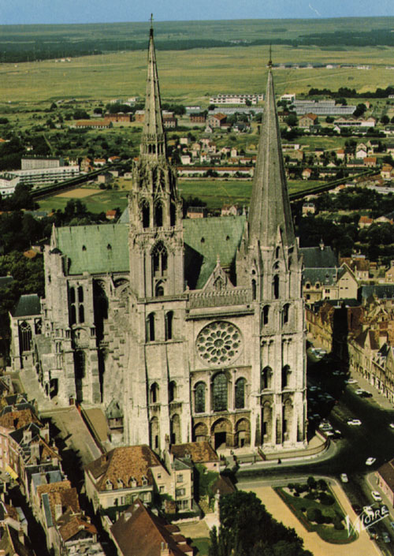

Slide 8
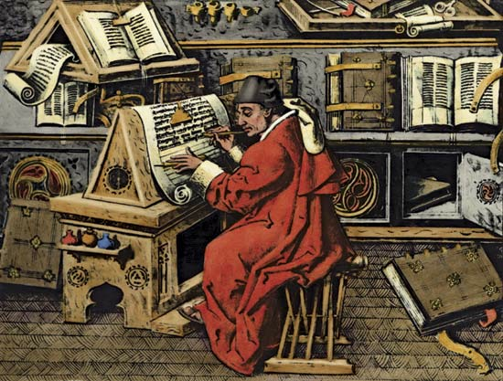
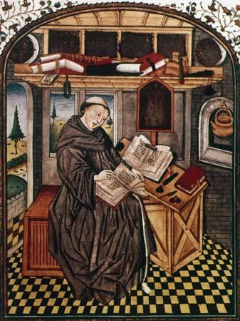
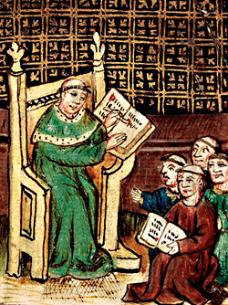
According to these painting of Catholic monks, what was the role of the Catholic Church in Medieval Europe?

Slide 9
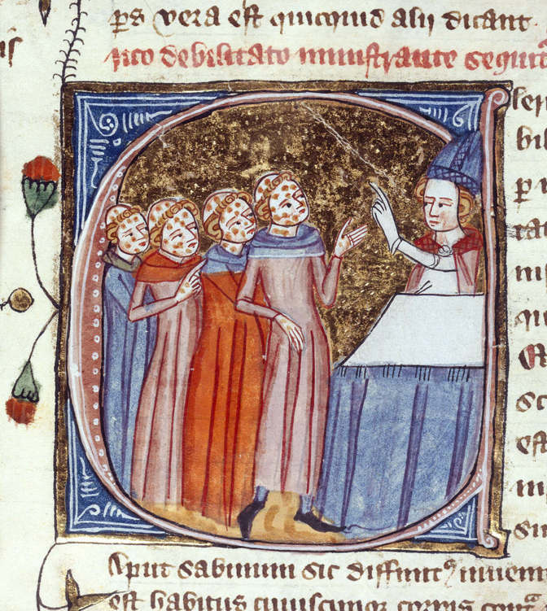
According to this drawing, what was the role of the Catholic Church in Medieval Europe?

Slide 10
In the following quote, Brigid is writing about bishops in the Church.
“An ape also has a human face, but the rest of its appearance like an animal. So too that man [i.e. the bishop] has a soul which is stamped with the seal of God, but is deformed by his own desires. Just as an ape touches and tramples the dirt with feet and hands, so that man covets earthly things, turning his face away from the heavenly things and
bending toward earthly ones like an oblivious animal. Did such a man ever lesson the wrath of God? Not at all-- in fact he provokes the justice of God against him.”
"On the Bishop", Brigid of Sweden, Revelationes 1.3.11
How can we use this as evidence for how the church abused its power in the Middle Ages?

Slide 11
Cities & Black Death

Slide 12
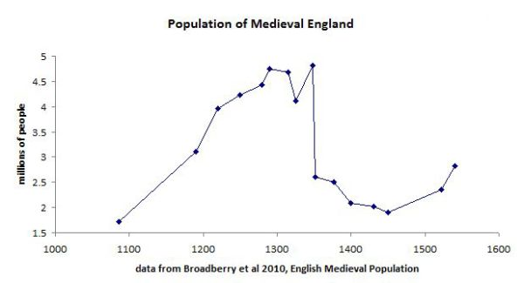
Why do you think the population plummets around 1350?
What could have caused this?
What happens to the population after 1100?
What’s the population at around 1090?

Slide 13
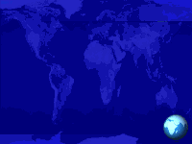
Describe Medieval Cities:
Enclosed by a wall
Winding, narrow streets
Filthy

Slide 14
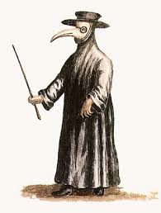
Doctor during the Black Death

Slide 15
What is the Black Death?
A disease that spread across Europe between 1346-1353
What caused the Black Death?
Rats brought it to Europe along the Silk Road.
How many people died?
1 out of every 3 people– around 50 million.
What were the effects of the Black Death?
Loss of faith in church
Higher wages for workers
Emphasis on education

