Slide 1
Unit 2, Lesson 9
Name________________________________ Section_______________ Date_________________
Text 1: The Geocentric View
Why would an astronomer like Ptolemy hold a geocentric and geostatic view of the Universe?
Why did so many ancestors accept this view?
Why do you think Ptolemy’s view of the universe didn’t include Neptune or Uranus?
How can this help you in your essay?
Text 3: Epicycles
What are epicycles?
2. How did adding epicycles help explain retrograde motion?
Text 2: Path of the Planets
Describe the retrograde motion of Mars.
What do you think could explain this unusual motion?
How would our ancestors explain it?
How can this help you in your essay?
Text 3: Epicycles
What are epicycles?
2. How did adding epicycles help explain retrograde motion?
3. How can this help you in your essay?

Slide 2
Unit 2, Lesson 9
Name________________________________ Section_______________ Date_________________
Text 4: Copernicus’s Heliocentric View
In the text, highlight/underline reasons why Copernicus changed his mind from a geocentric to a heliocentric view of the universe.
How can this help you in your essay?
Text 5: Galileo’s Letter to Kepler
Why was Galileo afraid to come forward to support Copernicus?
How can this help you in your essay?
Text 6: Galileo’s Telescope
Did Galileo’s discoveries support, extend, or challenge the geocentric/heliocentric view of the Universe?
2. How can this help you in your essay?
Text 7: Galileo Discovers the Moons of Jupiter
How did Galileo discover that there were moons around Jupiter?
2. Does this support Copernicus’s view of the Universe? How?
3. How can this help you in your essay?
Text 8: Heliocentric view grows in popularity
1. How can this help you in your essay?

Slide 3
Unit 2, Lesson 9
Name________________________________ Section_______________ Date_________________
LT: I can analyze multiple primary and secondary sources about s single topic
DBQ #1: When and why should individuals change their minds?
To help you think about this question, you’re going to look at two astronomers, Copernicus and Galileo. Both men questioned beliefs that had existed for over 2,000 years. And both men contributed to a new way of thinking about the Earth’s place in the Universe.
Throughout history, most people thought that the Earth was at the center of the Universe and that it did not move. This is called the geocentric view of the Universe. Copernicus and Galileo questioned that view and argued that the Earth and the other planets revolved around the Sun. This is the heliocentric view.
So, why did Copernicus and Galileo change their minds? Did they use any of our claim testers in their thinking? Can their cases help you develop an argument for when people should change their minds? How? Or do you think that their stories are not very helpful in answering this question?
To help you think about this question, you’re going to look at two astronomers, Copernicus and Galileo. Both men questioned beliefs that had existed for over 2,000 years. And both men contributed to a new way of thinking about the Earth’s place in the Universe.
Throughout history, most people thought that the Earth was at the center of the Universe and that it did not move. This is called the geocentric view of the Universe. Copernicus and Galileo questioned that view and argued that the Earth and the other planets revolved around the Sun. This is the heliocentric view.
So, why did Copernicus and Galileo change their minds? Did they use any of our claim testers in their thinking? Can their cases help you develop an argument for when people should change their minds? How? Or do you think that their stories are not very helpful in answering this question?

Slide 4
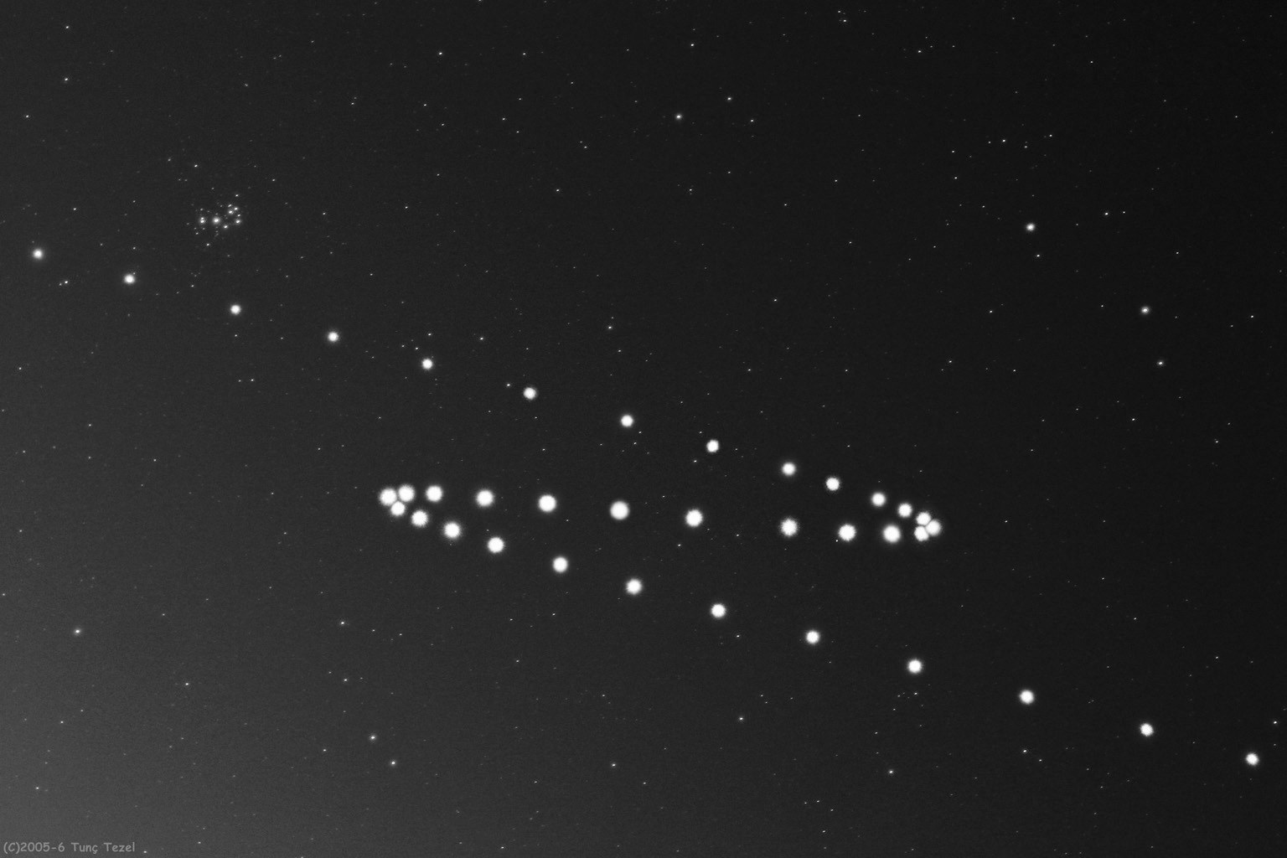
Source: Photo progression of Mars retrograde, nasa.gov, 2006

