Slide 1
Making Inferences about Paleolithic Life
Before you start, make sure that you go to “slide show”, then “play from beginning, to make the powerpoint full screen. Use the arrow keys to navigate.
As you go through the powerpoint, ask yourselves: What do these artifacts tell us about:
Social structure? How they spent their time? If they were spiritual or believed in an afterlife?

Slide 2
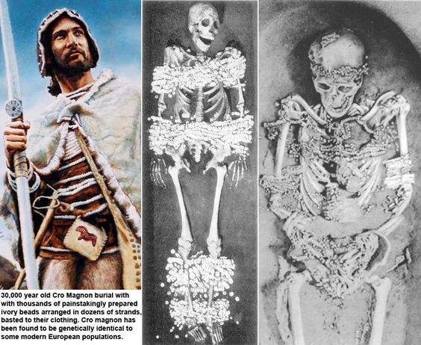
Artifact: Skeletons
Sungir, Russia

Slide 3
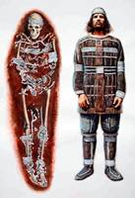
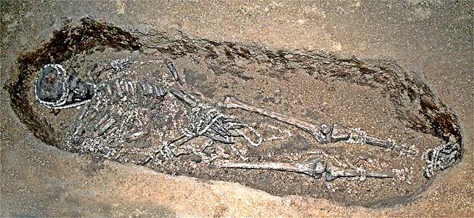
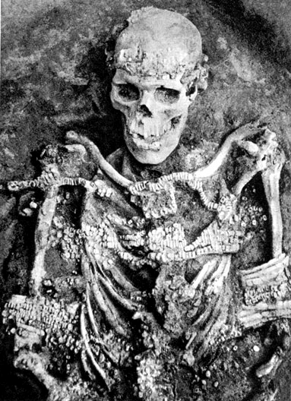
This skeleton is approximately 28 000 to 30 000 years old
The head and chest were decorated with many ivory beads, originally sewn onto cloth. Notice the mammoth-ivory bracelets on his arms, and the remains of the beaded cap on his head.
It is the skeleton of a full grown, adult male.

Slide 4
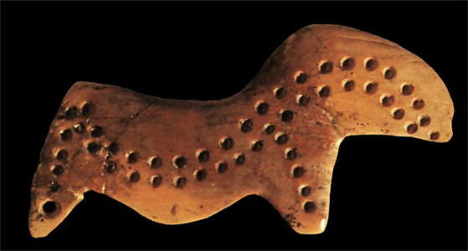
The man was adorned with 2,936 beads made of mammoth tusk arranged in strands found on all parts of his body including his head, which was apparently covered with a beaded cap that also bore several fox teeth.
Close up of bead
Experiments reveal that each of the ivory beads at Sungir took more than an hour to fabricate. Hence, the man's beadwork took more than 3,000 hours.
Note: The bead could be its own artifact, if you have an inference to make about it.

Slide 5
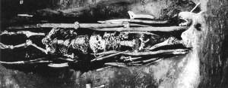
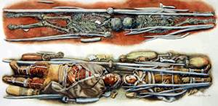
Two children, aged 8 and 13, were also found in Sungir, buried head to head with elaborately decorated clothes and other jewelry.
Very few of the skeletons found from the Paleolithic Era seem to have been purposefully buried.
What can we infer about Paleolithic Era life from these skeletons?

Slide 6
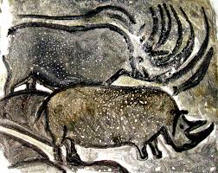
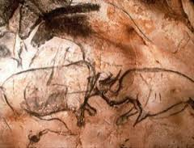
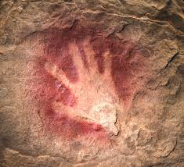
Artifact: The Cave Bear Skull
The Chauvet Caves, France

Slide 7
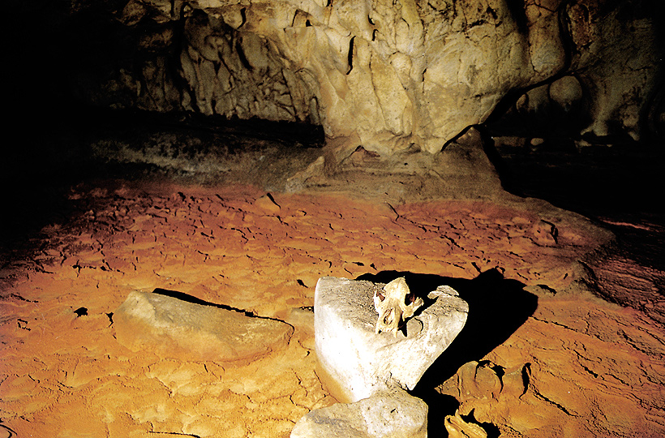
Another example of human activity within the cave can be found in the Skull Chamber. In this space it is possible to see prints and bones on the floor, and on the walls, claw marks, engravings, paintings, hand prints and torch wipes. But in the very centre a cave bear skull was moved and placed on the rock. This would have been done either 32,000 to 30,000 or 27,000 to 26,000 years ago. http://www.bradshawfoundation.com/
See that skull?

Slide 8
It’s the skull of the now extinct cave bear, estimated to be 50% bigger than a grizzly bear. This skull is about 30,000 years old. It was clearly moved and placed on a stone slab in the center of the cave. On the cave walls are claw marks, engravings, hand prints, and torch swipes. The cave floor was covered with the skeletons of 150 cave bears.
Some scientists think it shows spiritual reverence for animals (specifically cave bears). Others think it was just there for no reason.
What can you infer about Paleolithic life from this cave?

Slide 9
Artifact: Flute
Hohle Fell Caves, Germany

Slide 10
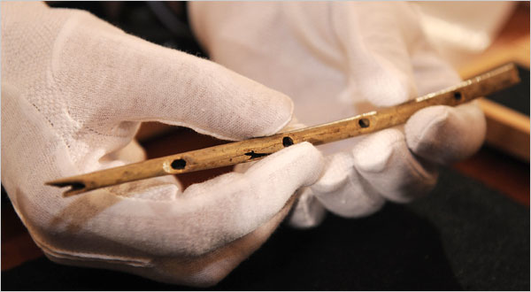
Carbon dating tells us that this flute is at least 35,000 years old. It is made from the the bones of a griffon vulture. Other flutes found were made of ivory, which are more difficult to make because the ivory has to be split, hollowed out, and refitted together.
Music experts say the instrument was well made and produced distinct musical notes.
What can we infer about Paleolithic Life from this flute?

Slide 11
Artifact: Therianthrope
Les Trois Freres Caves, France

Slide 12
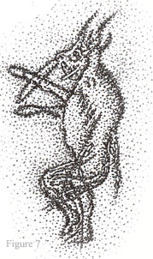
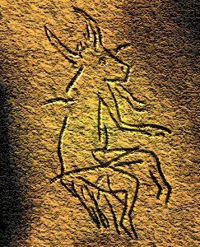
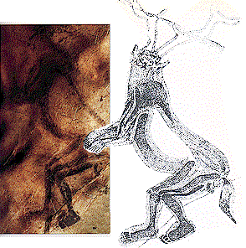
Therianthropes are basically human-animal mixes. While most Paleolithic cave paintings were of bison, bears, rhinos, and other large mammals, some caves have paintings or carvings therianthropes like the ones above.
What can we infer about Paleolithic Life from these therianthropes?
Some scientists believe these show spirituality– either humans blessed with animal characteristics, or animals being portrayed as humans.

Slide 13
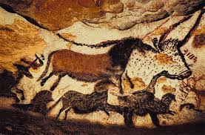
Artifact: Cave Paintings
Lascaux Caves, France

Slide 14
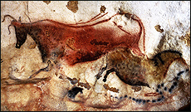
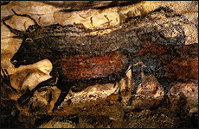
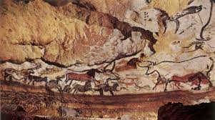
We’ve already looked at some grainy, black and white photos of the Lascaux Caves. We know that they’re about 18,000 years old, and that there are over 2,000 of them. If you have time, please click on this link to explore the Lascaux Caves a little. It’s in French, but who cares? The website’s really well done.
What can we infer about Paleolithic Life from these paintings?

Slide 15
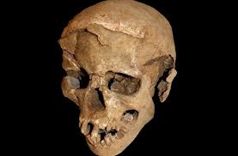
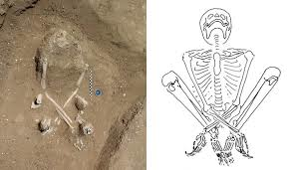
Artifact: Mass Grave
Kenya, Africa

Slide 16
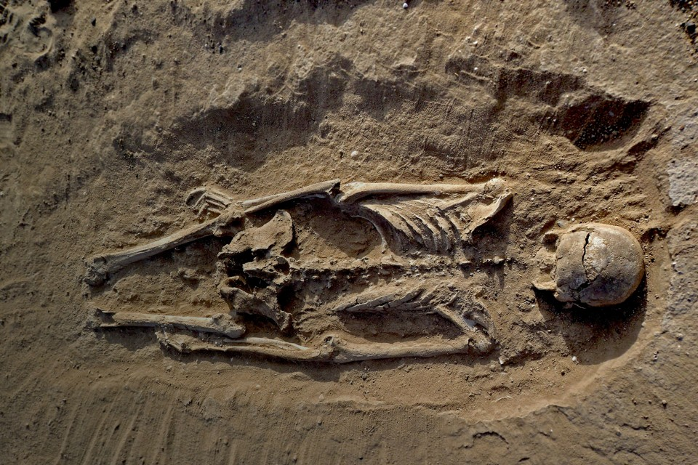
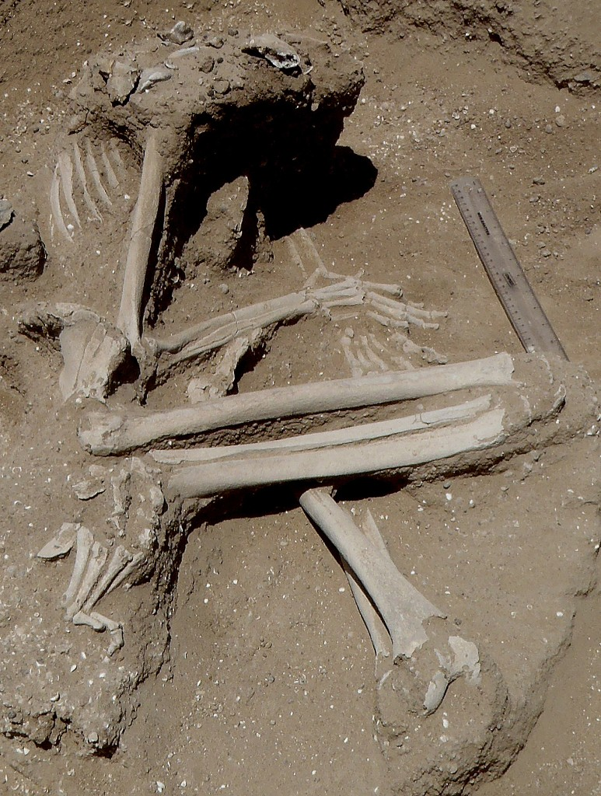
This mass grave in Kenya was discovered only recently. The 27 skeletons found in it are dated to be about 11,000 years old.” Ten of the bodies had signs of injuries that were likely lethal: Five showed evidence of blunt-force head trauma, and five or six (one was ambiguous) had markings consistent with arrow wounds around the head and neck. Several of the skeletons also had fractured hands, knees, and ribs, and some were found in positions suggesting that their arms and legs had been bound.”
Scientists note that 11,000 years ago, the Kenyan area was extremely well-resourced, with marshes, fertile soil, and access to water.
What can we infer about Paleolithic Life from these mass graves?

