Slide 1
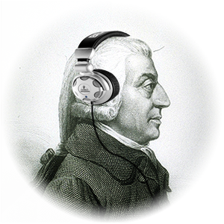
Aim: Is capitalism democratic?
Capitalism Pro’s
Capitalism Con’s
Encourages Innovation
Can lead to social mobility
Always an impoverished class
Profit can concentrate in the hands of a few

Slide 2
What is socialism?
Economic system in which most of the means of production are controlled by the community
2. How does Bernie Sanders want to apply socialist ideas to the United States?
Healthcare
Education
Social Security
Notes:
https://www.youtube.com/watch?v=MZJGlmb4F-M cow video
https://www.youtube.com/watch?v=K7jlAZSGXf4 bernie sanders

Slide 3
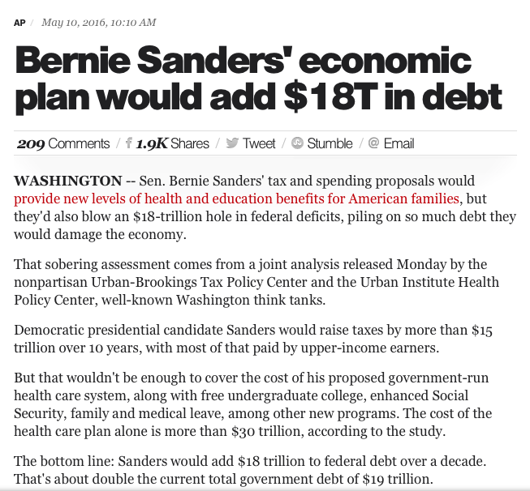
Notes:
https://www.youtube.com/watch?v=MZJGlmb4F-M
https://www.youtube.com/watch?v=K7jlAZSGXf4

Slide 4
Should individuals contribute to the welfare of everyone, or do you believe that individuals should be responsible for themselves?
Notes:
https://www.youtube.com/watch?v=MZJGlmb4F-M cow video
https://www.youtube.com/watch?v=K7jlAZSGXf4 bernie sanders

