Slide 1
What should the United States do about the Syrian Crisis?
The Syrian Crisis is really 2 parts:
ISIS is becoming more powerful and is now able to coordinate attacks. The land they control is mostly in Syria. Should we attack them or wait?
All the violence in Syria is driving out hundreds of thousands of refugees to Europe and the United States. Should we accept the refugees or not?

Slide 2
A Brief Background on ISIS

Slide 3
1. What does ISIS stand for?
The Islamic State of Iraq and Syria

Slide 4
2. What is ISIS?
A terrorist group that is ultra-fundamentalist Muslim, declaring everyone else to be the enemy (including Muslims who don’t fully agree/support ISIS)
They call themselves a caliphate, which is a worldwide Muslim community.

Slide 5
3. How did ISIS begin/gain strength?
After 9/11, the United States invaded Iraq, which was already a violent place. The U.S. dismissed 500,000 Iraqi soldiers, angering them and fostering anti-Western sentiment.
Meanwhile, the Syrian civil war was raging, creating chaos/a lack of political stability.

Slide 6
4. How is ISIS so rich?
They’ve taken over the oil fields of Syria and sell it on the black market.

Slide 7
4. How is ISIS so rich?
They’ve taken over the oil fields of Syria and sell it on the black market.
They regularly kidnap wealthy Syrians and hold them for ransom.
Social media– They’re good at creating videos and other propaganda, which creates fear in some and inspires others to join them.
ISIS NYC Propaganda video

Slide 8
5. What is the goal of ISIS?
They want to bring about the apocalypse, which they believe to be a day of judgment in which only the truly devout Muslims will survive.
First, though, they want to take over a large region in the Middle East.

Slide 9
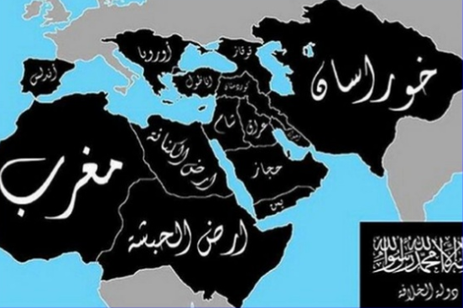
ISIS’s 5 Year Plan

Slide 10
Syrian refugee crisis

Slide 11
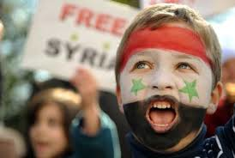
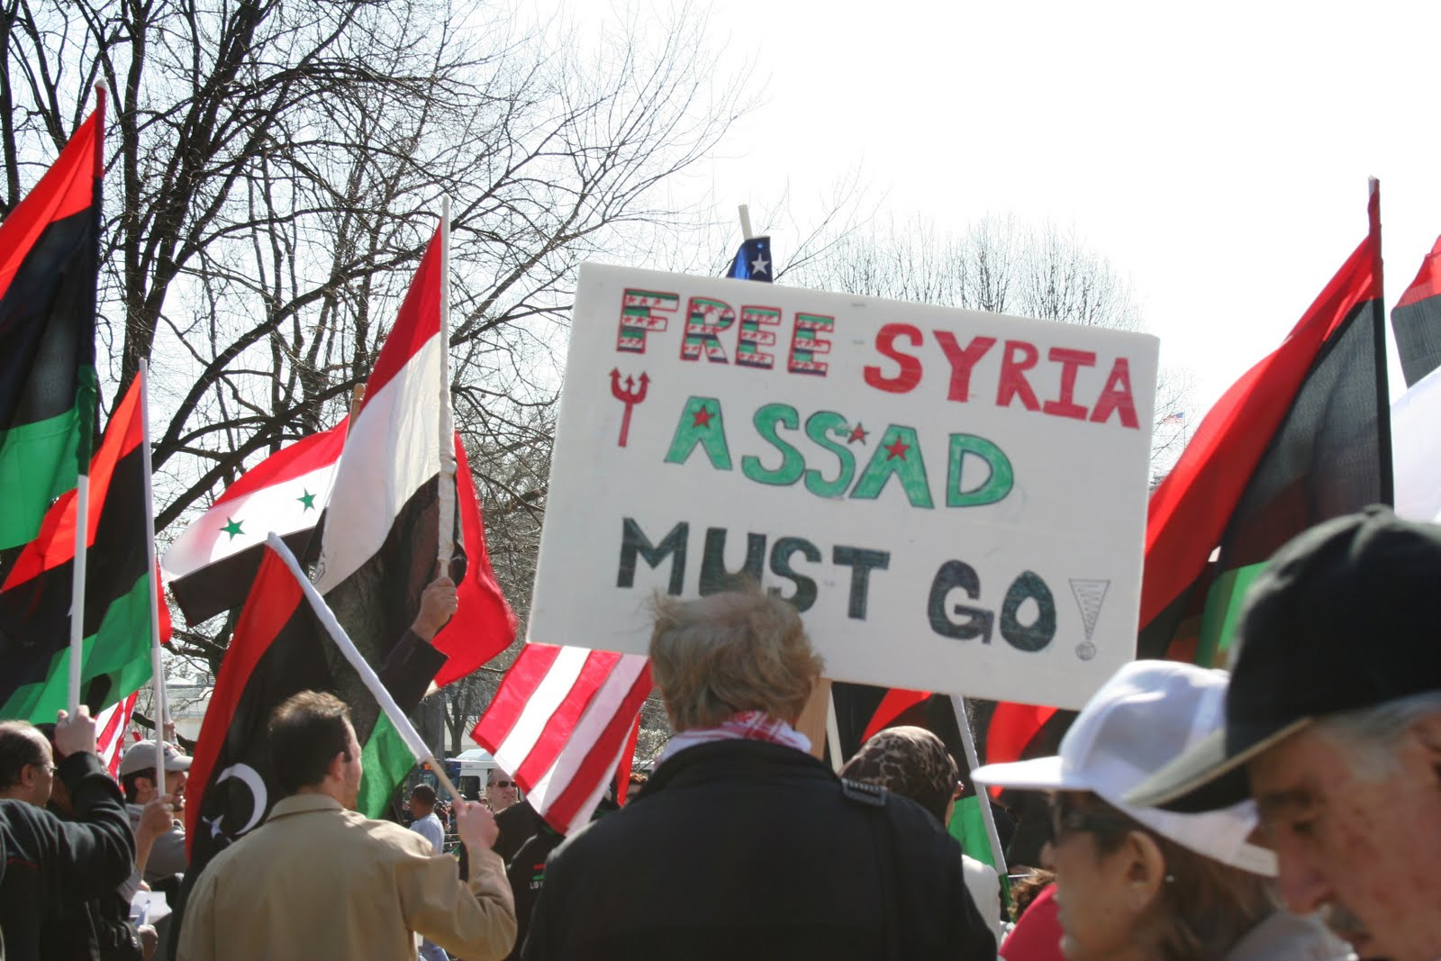
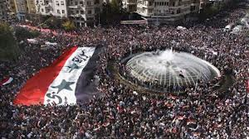
When people say “Syrian crisis”, what are they talking about?
Syrian civil war started with peaceful protests against Syrian President Bashar al-Assad in March 2011. They didn’t like that Assad and his buddies had almost all the power, and they didn’t like the violence he used to keep power.
Assad’s security forces responded with brutal violence, which made the protesters furious. The protesters organized themselves into a violent rebellion, causing civil war.

Slide 12
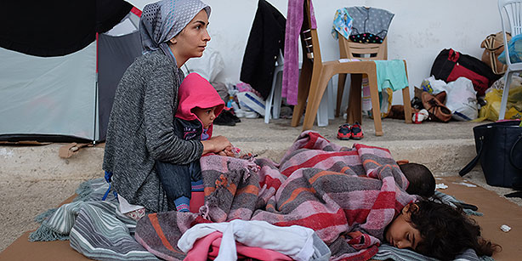
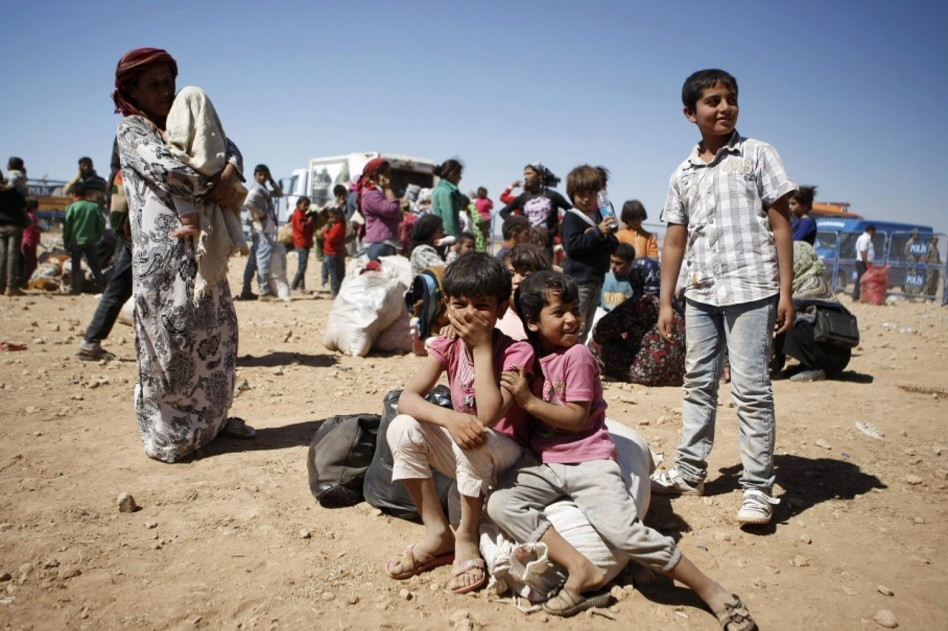

Slide 13
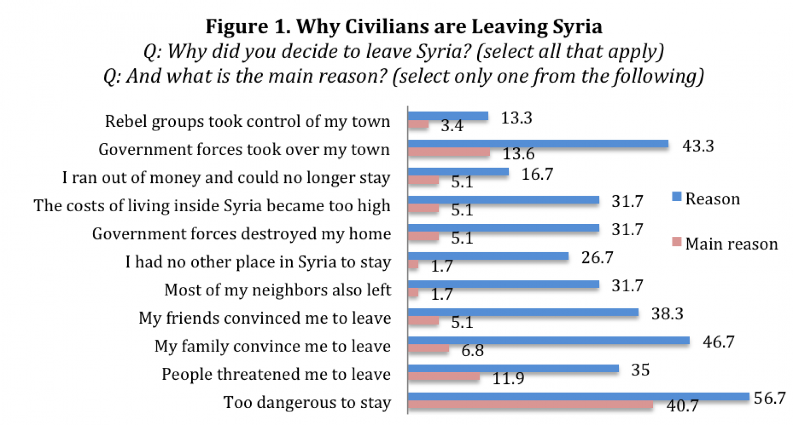
Source: Washington Post

