Slide 1
What does it mean to be “hungry”?
Not getting enough calories, vitamins, or minerals.

Slide 2
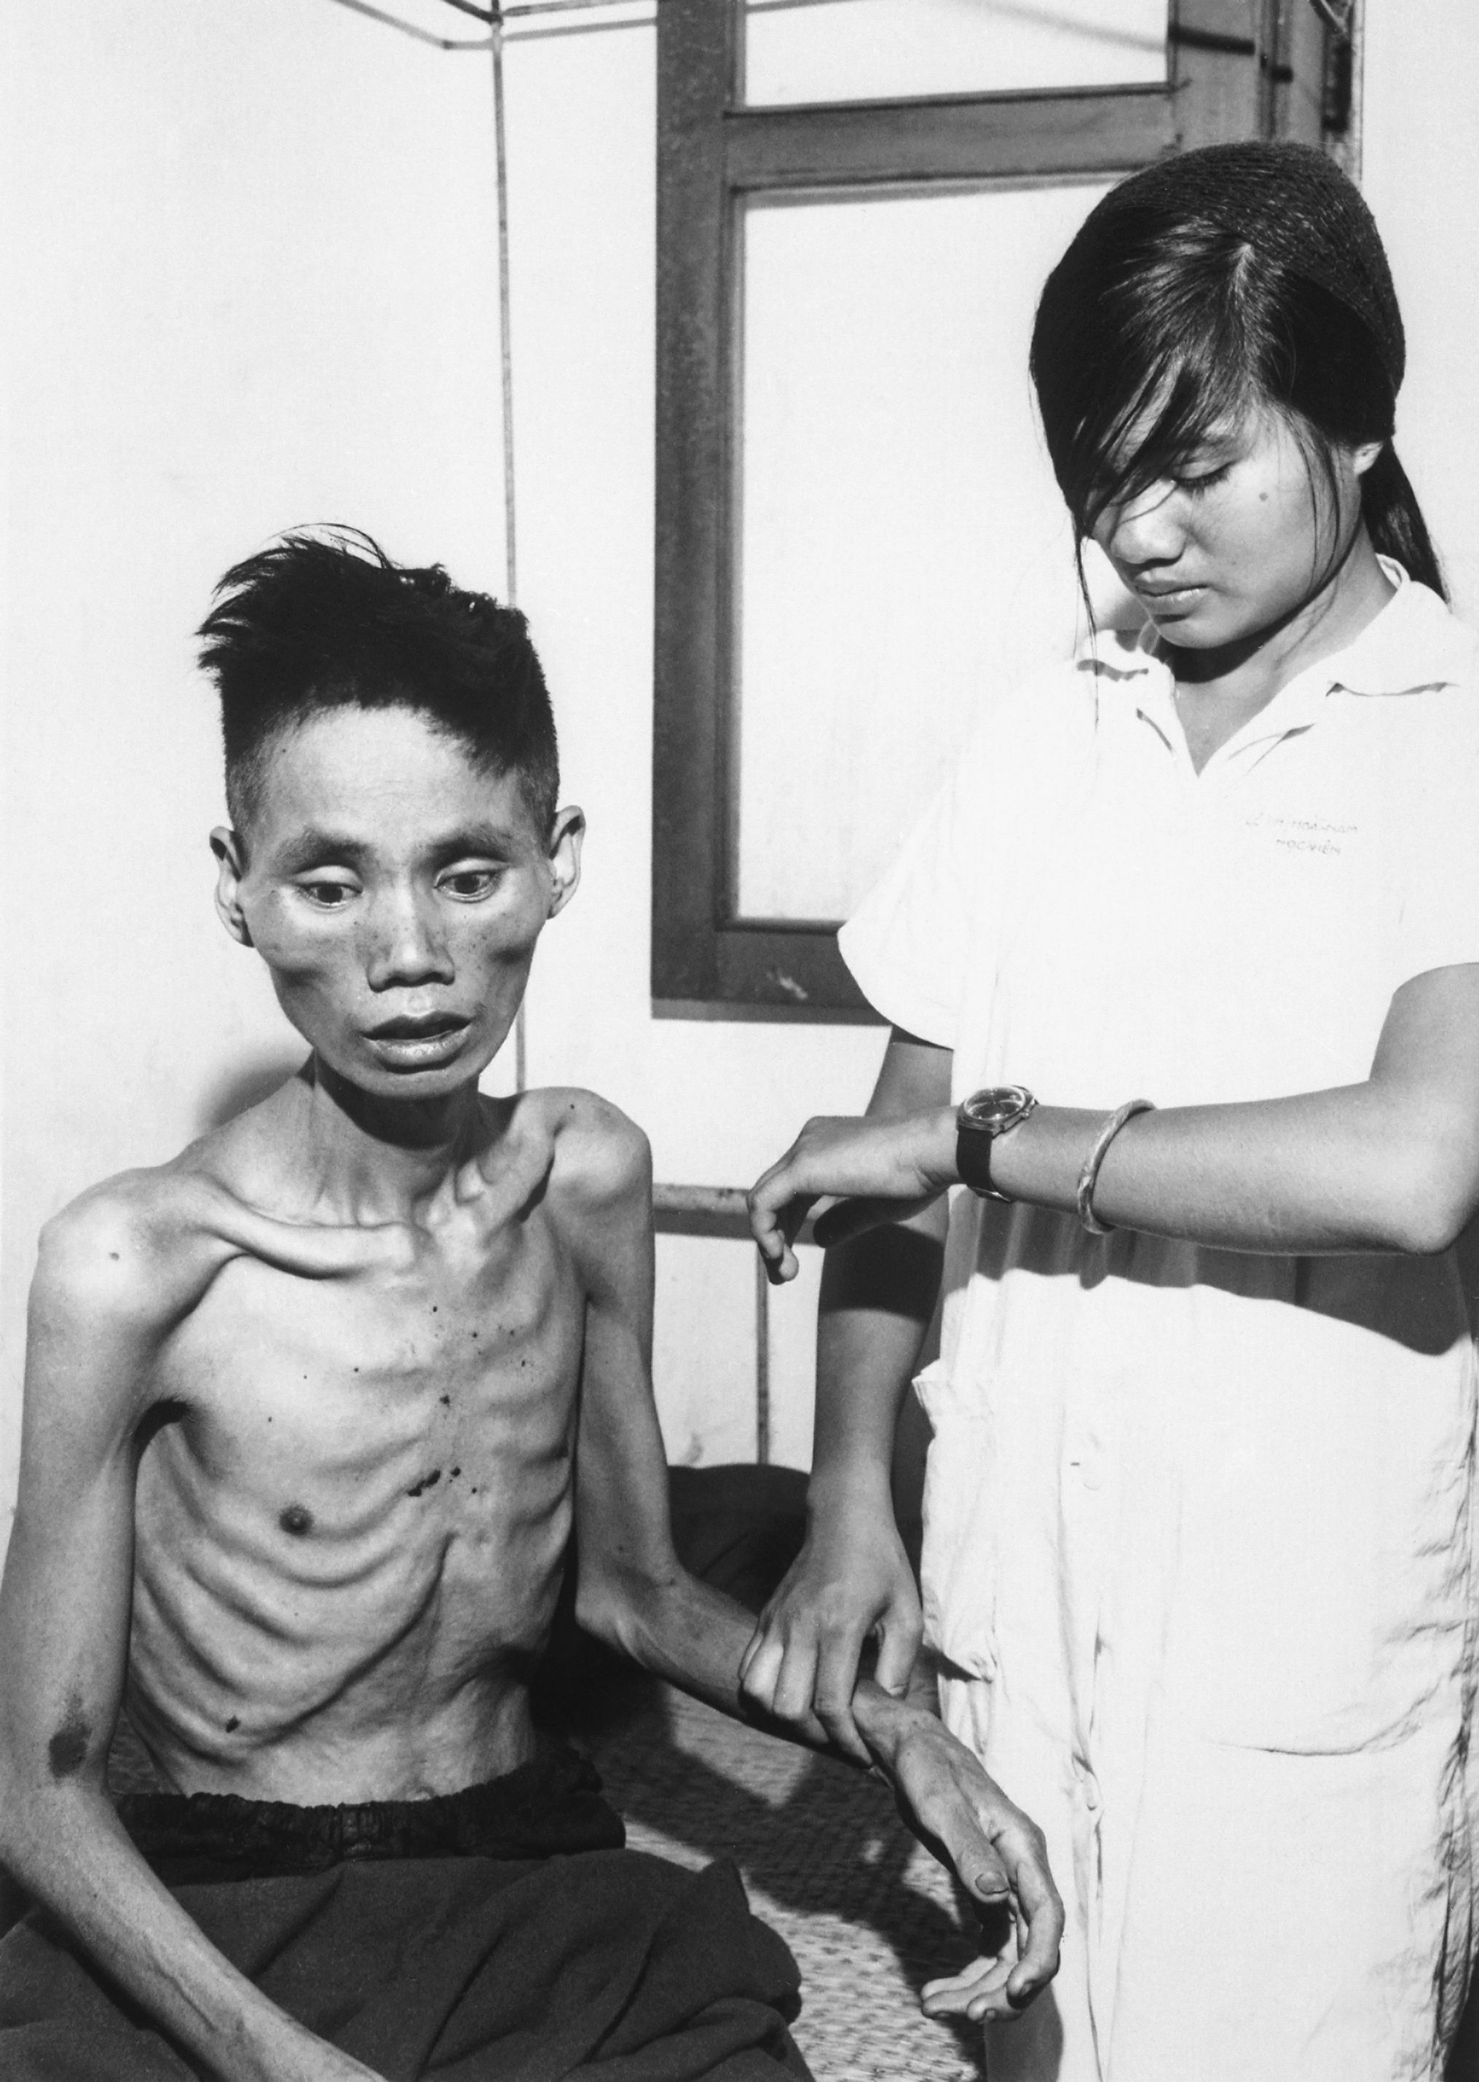
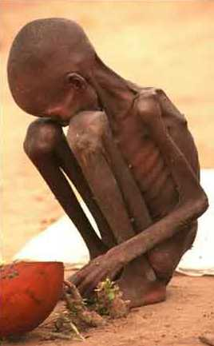
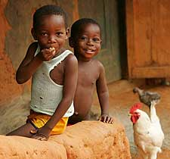
There are two types of hunger:
Wasting: Not receiving enough calories, starving
Stunting: Receiving calories, but not receiving enough nutrients & vitamins
Notes:
Though it doesn’t look as serious, chronic hunger kills more people than acute starvation. They simply don’t have the vitamins and nutrients needed to function and protect themselves against sickness.

Slide 3
2. What are the effects of hunger?
The body no longer has the energy to perform physical and mental activities.
Lack of concentration
Body systems fail
Weakened immune system: cannot fight off common infections
Bones stop growing, skin cracks

Slide 4
2. What causes the hunger crisis? Is there not enough food?
Poverty trap: People are weak from hunger and don’t have the energy to work. If they can’t work, then they can’t earn money for food, and they stay hungry.
Price of food keeps rising

Slide 5
2. What causes the hunger crisis? Is there not enough food?
Poverty trap: People are weak from hunger and don’t have the energy to work. If they can’t work, then they can’t earn money for food, and they stay hungry.
Price of food keeps rising
Food wastage: One third of all food produced is never consumed.

Slide 6
2. What causes the hunger crisis? Is there not enough food?
Poverty trap: People are weak from hunger and don’t have the energy to work. If they can’t work, then they can’t earn money for food, and they stay hungry.
Price of food keeps rising
Food wastage: One third of all food produced is never consumed.
Climate and weather: Destroys crops and kills animals.

Slide 7
How would you propose to solve the hunger crisis?

Slide 8
Claim:
Aquaculture is the most promising solution to the world hunger crisis

Slide 9
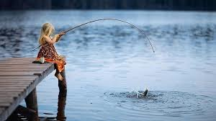
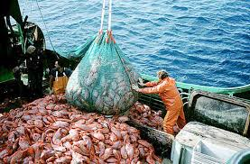
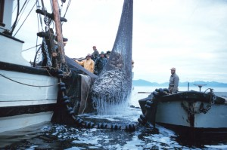
Wild-caught fish is basically hunting & gathering

Slide 10
What is aquaculture?
The farming of fish and other plants.
Notes:
http://www.nmfs.noaa.gov/aquaculture/faqs/faq_aq_101.html#3whydo

Slide 11
2. What is aquaculture used for?
Restoring endangered aquatic species
Restoring the the environment
Providing fish for aquariums
Creating supplements & vitamins
Producing seafood to be eaten
Notes:
http://www.nmfs.noaa.gov/aquaculture/faqs/faq_aq_101.html#3whydo

